Slide 1
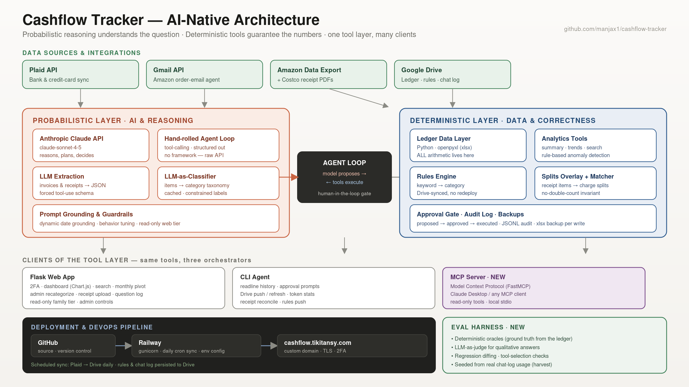
Notes:
Cashflow Tracker — talking points: • Thesis: probabilistic layer understands the question; deterministic layer guarantees the numbers. The model never does arithmetic — all math is in code; the model reasons and decides. • Agentic AI: hand-rolled tool-calling loop over the raw Anthropic API (no framework) — I understand what LangGraph etc. abstract. • Structured outputs via forced tool-use for invoice/receipt extraction; LLM-as-classifier constrained to my own category taxonomy, with caching for cost control. • Human-in-the-loop: every mutation is proposed → approved → executed, with audit log and backups. Safety in code, not prompts. • Multi-source ingestion: Plaid (bank), Gmail API agent (Amazon emails), Amazon data export, Costco receipt PDFs → non-destructive Splits overlay with a proven no-double-count invariant. • Deployed: Flask + 2FA (TOTP) web app on Railway, custom domain + TLS, self-refreshing from Google Drive; GitHub source; daily scheduled Plaid→Drive sync; rules & chat log Drive-synced. • Tested with an eval harness: deterministic oracles compute ground truth from the ledger, an LLM-as-judge grades qualitative answers against those facts, with regression diffing and cases seeded from real usage. • Interoperable via MCP: the same tool layer is exposed as a Model Context Protocol server, so Claude Desktop and any MCP client drive the ledger alongside the web and CLI agents — one tool layer, three orchestrators. • Debugged through real failure modes: temporal grounding, over-cautious tool avoidance, confident misinference, silent false-negatives, last-writer-wins clobber — operating at every altitude, hands-on.

